Slide 1
2. Termination
1. Emulation
5. Pricing
3. Claims
8. Catastrophe
4. Rates
6. Products
10. James
9. Cricket
11. Report 11
12. Report 12
13. Report 13
14. Report 14
15. Report 15
16. Report 16
17. Report 17
18. Report 18
21. Individual 1
22. Individual 2
32. Self 1
33. Self 2
23. Individual 3
24. Individual 4
25. Individual 5
31. Partner
33. Self 2
32. Self 1
26. Individual 6
27. Individual 7
19. Report 19
20. Report 20
28. Individual 8
19. Report 19
29. Individual 9
30. Individual 10

Slide 2
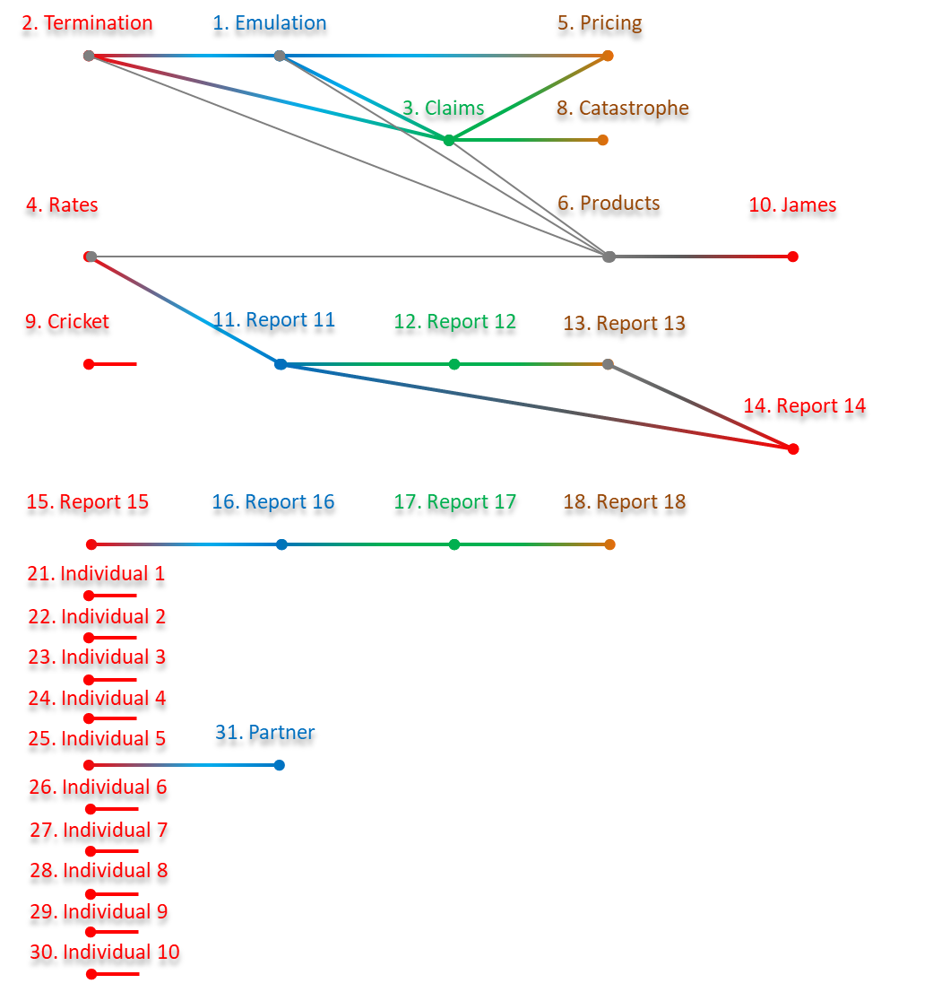
RUN_LAYER
1
2
3
4
5
RUN_GROUP
1
2
3
4
5
6
7
8
9
10
11
12

Slide 3
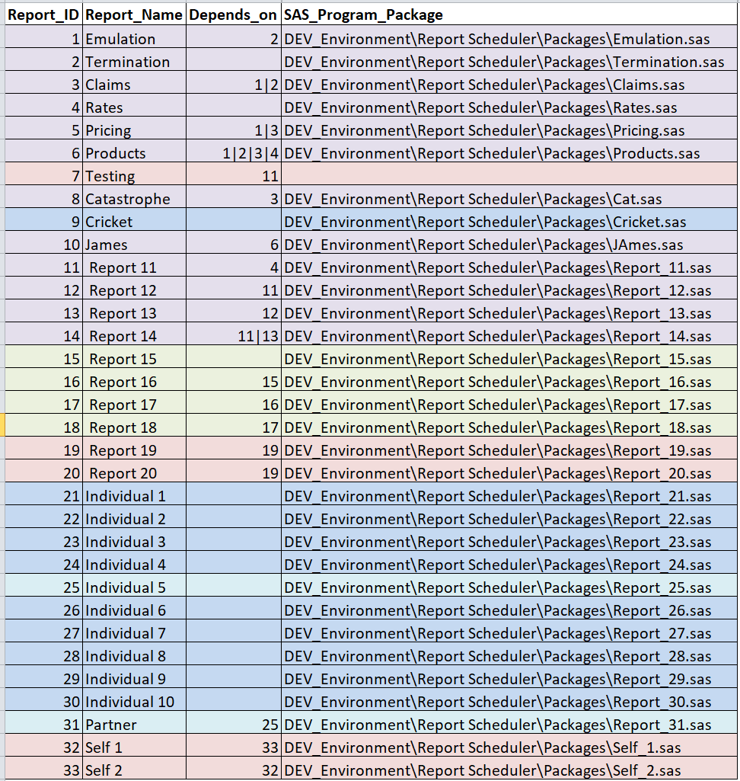

Slide 4
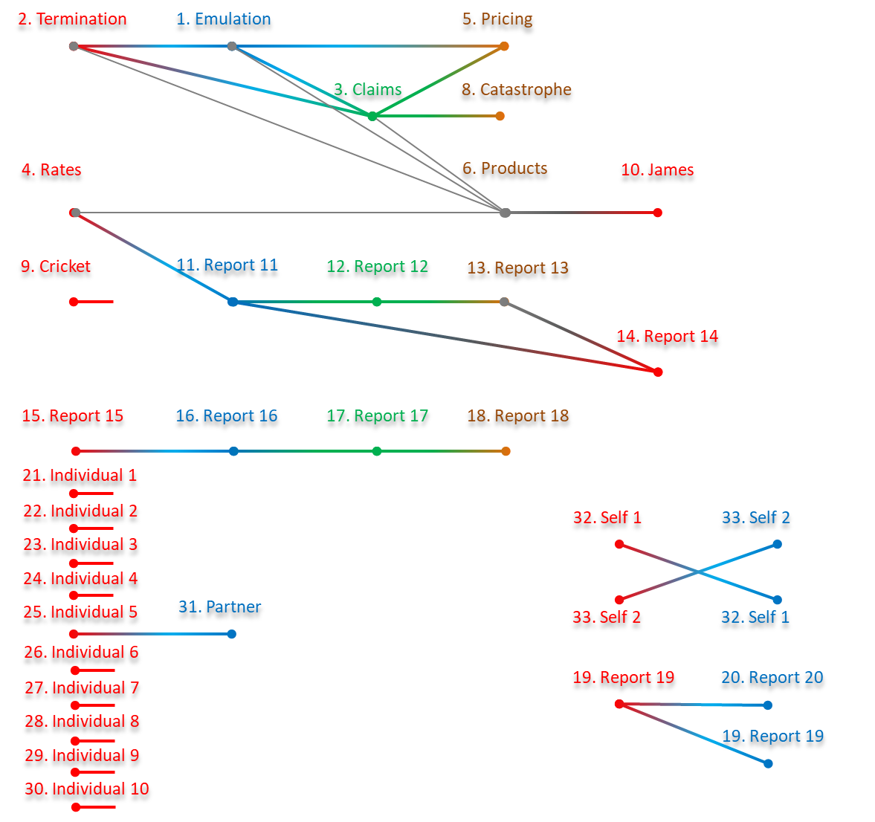

Slide 5
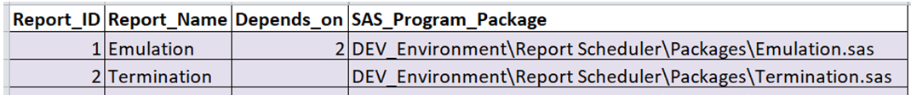
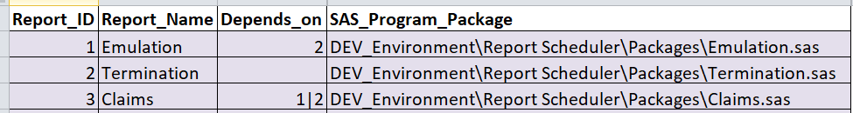
2. Termination
1. Emulation
2. Termination
1. Emulation
3. Claims

Slide 6
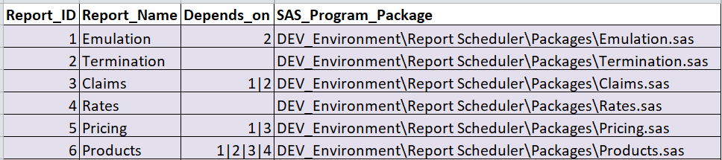
2. Termination
1. Emulation
5. Pricing
3. Claims
4. Rates
6. Products
RUN_LAYER
1
2
3
4
2. Termination
1. Emulation
5. Pricing
3. Claims
4. Rates
6. Products

Slide 7
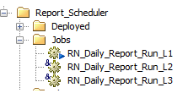
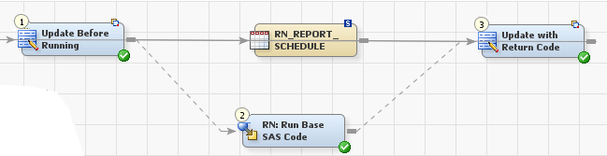
L1
No parallelism; parse Run Order
Select Distinct Run Order Asc
L2
In parallel
Select entry Where Run Order = Parsed Run Order
L3
Set to Running
Set to Complete
SAS Batch command

Slide 8
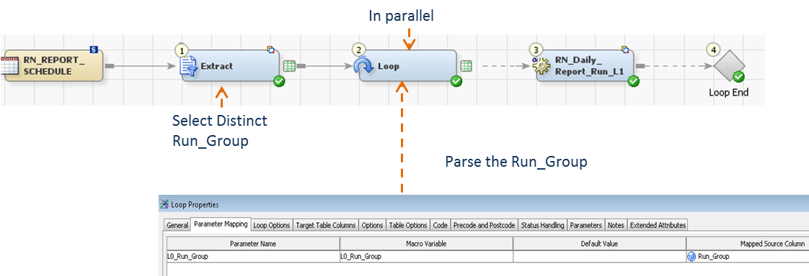
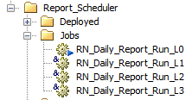
L0
L1
No parallelism; parse Run Order
Select Distinct Run Order Asc
L2
In parallel
Select entry Where Run Order = Parsed Run Order
L3
Set to Running
Set to Complete
SAS Batch command

Slide 9
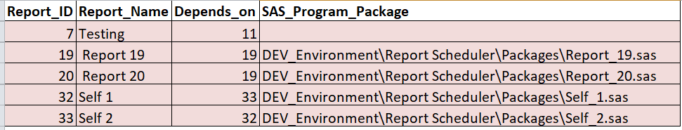
32. Self 1
33. Self 2
33. Self 2
32. Self 1
19. Report 19
20. Report 20
19. Report 19

Slide 10
THESE ARE NOT REAL DEPENDENCIES

Slide 11



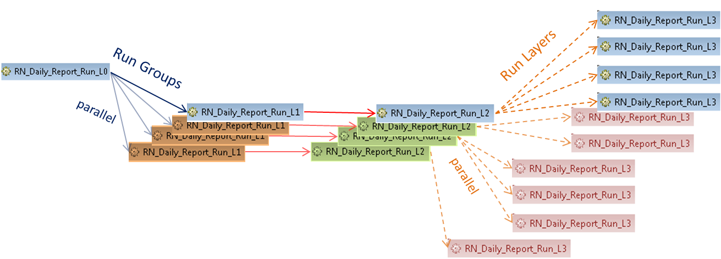
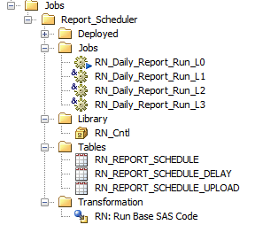

Slide 12
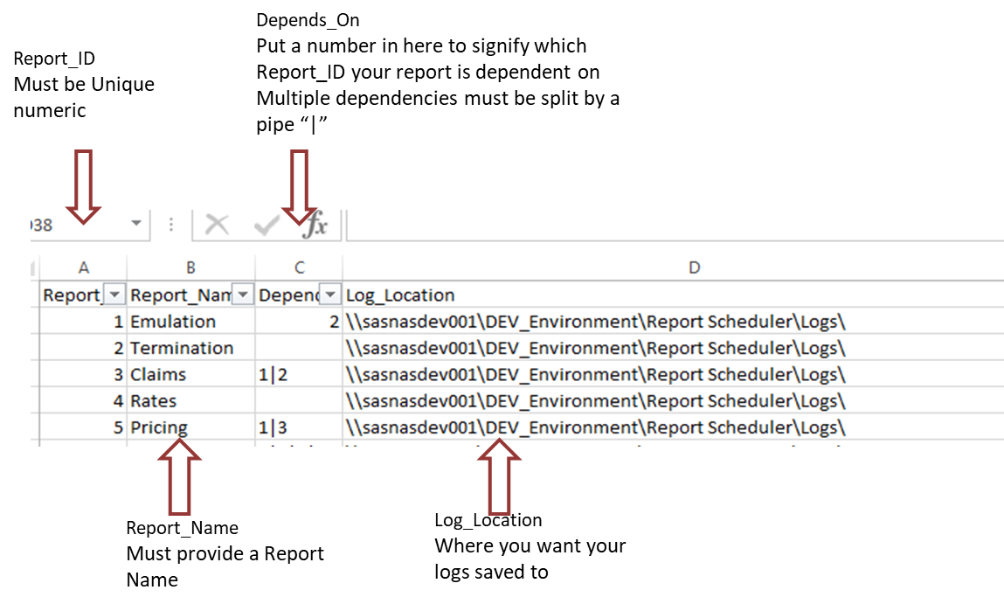
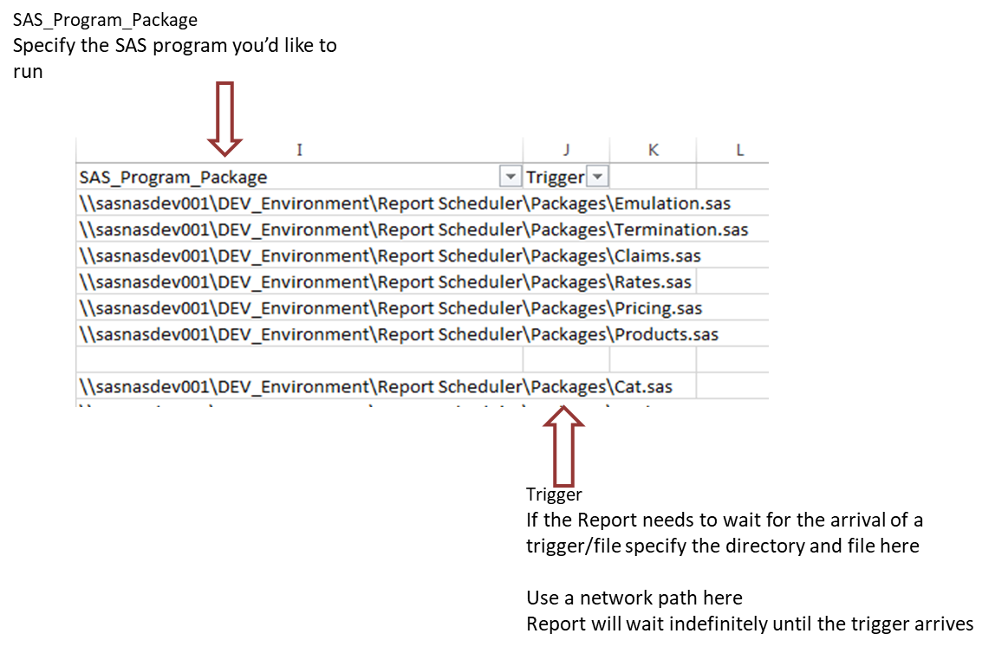
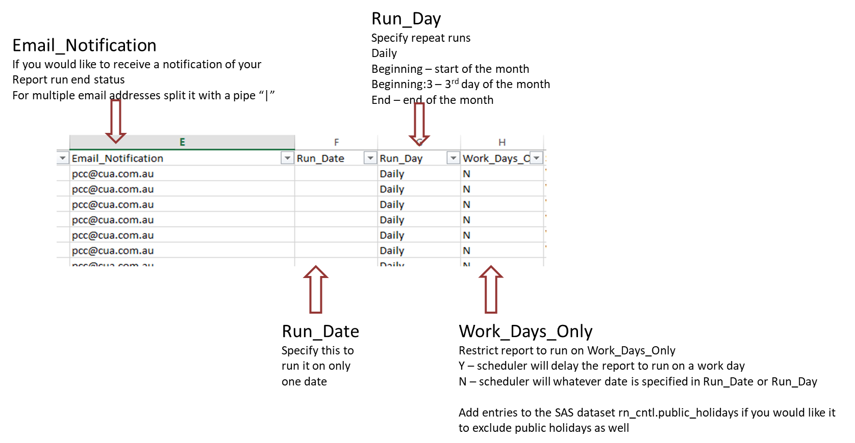

Slide 13
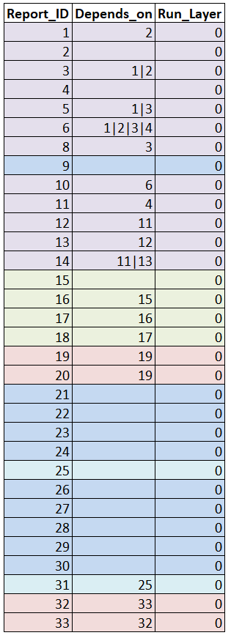
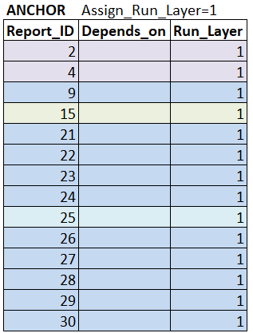

Slide 14
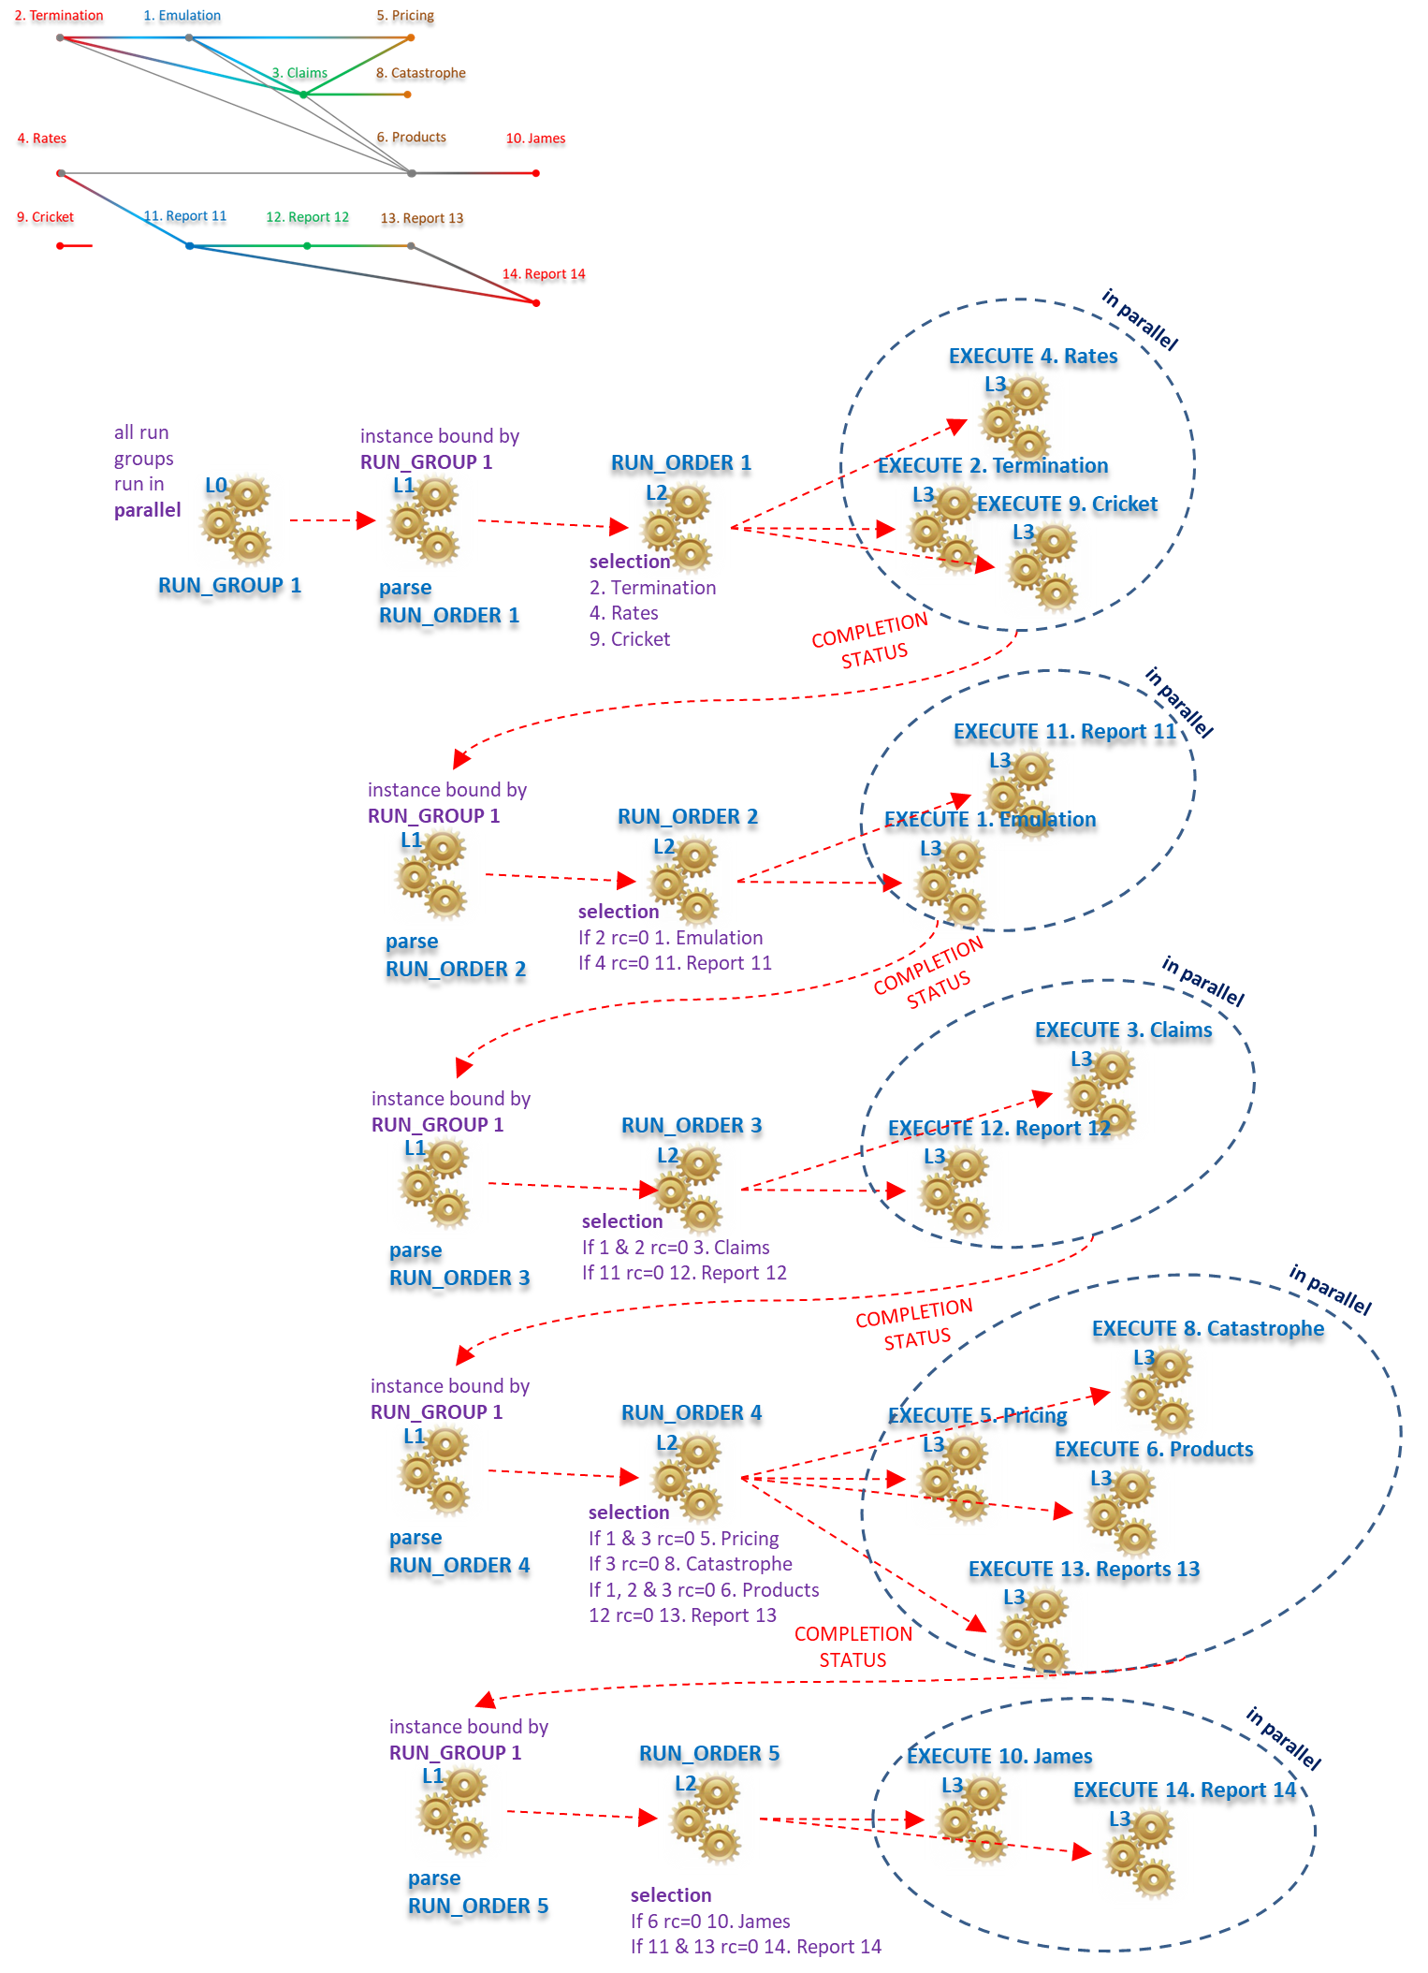

Slide 15
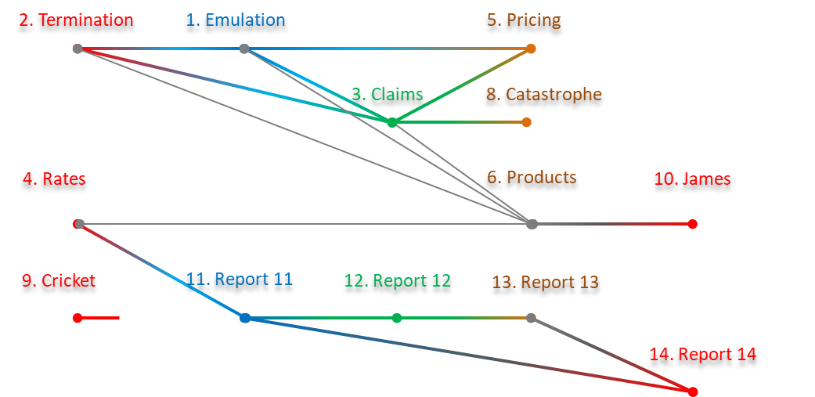

EXECUTE 4. Rates
L3
all run groups run in parallel
instance bound by RUN_GROUP 1
RUN_ORDER 1
EXECUTE 2. Termination
L0
L1
L2
L3
EXECUTE 9. Cricket
L3
RUN_GROUP 1
parse RUN_ORDER ascending
parse selection
2. Termination
4. Rates
9. Cricket
…in parallel
COMPLETION STATUS
…parse 1
EXECUTE 11. Report 11
L3
instance bound by RUN_GROUP 1
RUN_ORDER 2
EXECUTE 1. Emulation
L1
L2
L3
parse RUN_ORDER ascending
parse selection
If 2 rc=0 1. Emulation
If 4 rc=0 11. Report 11
…in parallel
COMPLETION STATUS
…parse 2
EXECUTE 3. Claims
L3
instance bound by RUN_GROUP 1
RUN_ORDER 2
EXECUTE 12. Report 12
L1
L2
L3
parse RUN_ORDER ascending
parse selection
If 1 & 2 rc=0 3. Claims
If 11 rc=0 12. Report 12
…in parallel
COMPLETION STATUS
EXECUTE 8. Catastrophe
…parse 3
L3
instance bound by RUN_GROUP 1
RUN_ORDER 2
EXECUTE 5. Pricing
L1
L2
L3
EXECUTE 6. Products
L3
parse RUN_ORDER ascending
parse selection
If 1 & 3 rc=0 5. Pricing
If 3 rc=0 8. Catastrophe
If 1, 2 & 3 rc=0 6. Products
12 rc=0 13. Report 13
…in parallel
EXECUTE 13. Reports 13
L3
…parse 3
instance bound by RUN_GROUP 1
RUN_ORDER 2
EXECUTE 10. James
L1
L2
L3
EXECUTE 14. Report 14
L3
parse RUN_ORDER ascending
parse selection
If 6 rc=0 10. James
If 11 & 13 rc=0 14. Report 14
…in parallel
…parse 3

Slide 16
in parallel
EXECUTE 4. Rates
L3
all run groups run in parallel
instance bound by RUN_GROUP 1
RUN_ORDER 1
EXECUTE 2. Termination
L0
L1
L2
L3
EXECUTE 9. Cricket
L3
selection
2. Termination
4. Rates
9. Cricket
RUN_GROUP 1
parse RUN_ORDER 1
COMPLETION STATUS
in parallel
EXECUTE 11. Report 11
L3
instance bound by RUN_GROUP 1
RUN_ORDER 2
EXECUTE 1. Emulation
L1
L2
L3
selection
If 2 rc=0 1. Emulation
If 4 rc=0 11. Report 11
parse RUN_ORDER 2
COMPLETION STATUS
in parallel
EXECUTE 3. Claims
L3
instance bound by RUN_GROUP 1
RUN_ORDER 3
EXECUTE 12. Report 12
L1
L2
L3
selection
If 1 & 2 rc=0 3. Claims
If 11 rc=0 12. Report 12
parse RUN_ORDER 3
in parallel
COMPLETION STATUS
EXECUTE 8. Catastrophe
L3
instance bound by RUN_GROUP 1
RUN_ORDER 4
EXECUTE 5. Pricing
L1
L2
L3
EXECUTE 6. Products
L3
selection
If 1 & 3 rc=0 5. Pricing
If 3 rc=0 8. Catastrophe
If 1, 2 & 3 rc=0 6. Products
12 rc=0 13. Report 13
parse RUN_ORDER 4
EXECUTE 13. Reports 13
L3
COMPLETION STATUS
instance bound by RUN_GROUP 1
in parallel
RUN_ORDER 5
EXECUTE 10. James
L1
L2
L3
EXECUTE 14. Report 14
L3
parse RUN_ORDER 5
selection
If 6 rc=0 10. James
If 11 & 13 rc=0 14. Report 14

Slide 17
in parallel
EXECUTE 4. Rates
L3
all run groups run in parallel
instance bound by RUN_GROUP 1
RUN_ORDER 1
EXECUTE 2. Termination
L0
L1
L2
L3
EXECUTE 9. Cricket
L3
selection
2. Termination
4. Rates
9. Cricket
RUN_GROUP 1
parse RUN_ORDER 1
COMPLETION STATUS
in parallel
EXECUTE 11. Report 11
L3
instance bound by RUN_GROUP 1
RUN_ORDER 2
EXECUTE 1. Emulation
L1
L2
L3
selection
If 2 rc=0 1. Emulation
If 4 rc=0 11. Report 11
parse RUN_ORDER 2
COMPLETION STATUS
in parallel
EXECUTE 3. Claims
L3
instance bound by RUN_GROUP 1
RUN_ORDER 2
EXECUTE 12. Report 12
L1
L2
L3
selection
If 1 & 2 rc=0 3. Claims
If 11 rc=0 12. Report 12
parse RUN_ORDER 3
in parallel
COMPLETION STATUS
EXECUTE 8. Catastrophe
L3
instance bound by RUN_GROUP 1
RUN_ORDER 2
EXECUTE 5. Pricing
L1
L2
L3
EXECUTE 6. Products
L3
selection
If 1 & 3 rc=0 5. Pricing
If 3 rc=0 8. Catastrophe
If 1, 2 & 3 rc=0 6. Products
12 rc=0 13. Report 13
parse RUN_ORDER 4
EXECUTE 13. Reports 13
L3
COMPLETION STATUS
instance bound by RUN_GROUP 1
in parallel
RUN_ORDER 2
EXECUTE 10. James
L1
L2
L3
EXECUTE 14. Report 14
L3
parse RUN_ORDER 5
selection
If 6 rc=0 10. James
If 11 & 13 rc=0 14. Report 14

Slide 18
in parallel
all run groups run in parallel
instance bound by RUN_GROUP 2
RUN_ORDER 1
EXECUTE 15. Report 15
L0
L1
L2
L3
selection
15. Report 15
RUN_GROUP 2
parse RUN_ORDER 1
COMPLETION STATUS
in parallel
instance bound by RUN_GROUP 2
RUN_ORDER 2
EXECUTE 16. Report 16
L1
L2
L3
selection
If 15 rc=0 16. Report 16
parse RUN_ORDER 2
COMPLETION STATUS
instance bound by RUN_GROUP 2
RUN_ORDER 2
EXECUTE 17. Report 17
L1
L2
L3
selection
If 16 rc=0 17. Report 17
parse RUN_ORDER 3
COMPLETION STATUS
instance bound by RUN_GROUP 2
RUN_ORDER 4
EXECUTE 18. Report 18
L1
L2
L3
selection
If 17 rc=0 18. Report 18
parse RUN_ORDER 4

Slide 19
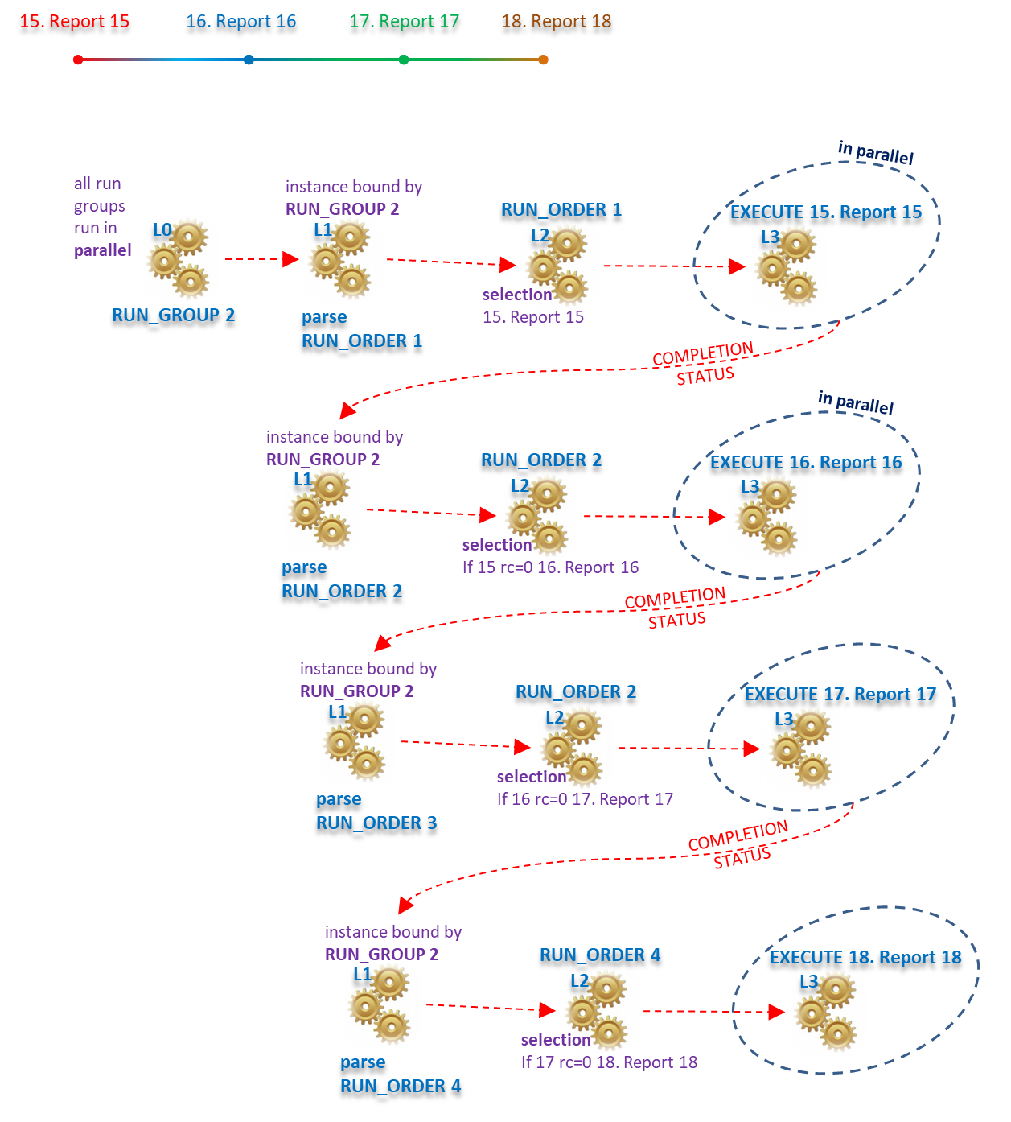

Slide 20
21. Individual 1
in parallel
all run groups run in parallel
instance bound by RUN_GROUP 3
22. Individual 2
RUN_ORDER 1
EXECUTE 21. Individual 1
23. Individual 3
L0
L1
L2
L3
24. Individual 4
selection
21. Individual 1
25. Individual 5
31. Partner
RUN_GROUP 3
parse RUN_ORDER 1
in parallel
26. Individual 6
all run groups run in parallel
instance bound by RUN_GROUP 4
RUN_ORDER 1
EXECUTE 22. Individual 2
27. Individual 7
L0
L1
L2
L3
28. Individual 8
29. Individual 9
selection
22. Individual 2
RUN_GROUP 4
parse RUN_ORDER 1
30. Individual 10
in parallel
all run groups run in parallel
instance bound by RUN_GROUP 5
RUN_ORDER 1
EXECUTE 23. Individual 3
L0
L1
L2
L3
selection
23. Individual 3
RUN_GROUP 5
parse RUN_ORDER 1
in parallel
all run groups run in parallel
instance bound by RUN_GROUP 6
RUN_ORDER 1
EXECUTE 24. Individual 4
L0
L1
L2
L3
selection
24. Individual 4
RUN_GROUP 6
parse RUN_ORDER 1
in parallel
all run groups run in parallel
instance bound by RUN_GROUP 7
RUN_ORDER 1
EXECUTE 25. Individual 5
L0
L1
L2
L3
selection
25. Individual 5
RUN_GROUP 7
parse RUN_ORDER 1
COMPLETION STATUS
in parallel
instance bound by RUN_GROUP 7
RUN_ORDER 1
EXECUTE 31. Partner
L1
L2
L3
selection
If 25 rc=0 31. Partner
parse RUN_ORDER 2
in parallel
all run groups run in parallel
instance bound by RUN_GROUP 8
RUN_ORDER 1
EXECUTE 26. Individual 6
L0
L1
L2
L3
selection
26. Individual 6
RUN_GROUP 8
parse RUN_ORDER 1
in parallel
all run groups run in parallel
instance bound by RUN_GROUP 9
RUN_ORDER 1
EXECUTE 27. Individual 7
L0
L1
L2
L3
selection
27. Individual 7
RUN_GROUP 9
parse RUN_ORDER 1
in parallel
all run groups run in parallel
instance bound by RUN_GROUP 10
RUN_ORDER 1
EXECUTE 28. Individual 8
L0
L1
L2
L3
selection
28. Individual 8
RUN_GROUP 10
parse RUN_ORDER 1
in parallel
all run groups run in parallel
instance bound by RUN_GROUP 11
RUN_ORDER 1
EXECUTE 29. Individual 9
L0
L1
L2
L3
selection
29. Individual 9
RUN_GROUP 11
parse RUN_ORDER 1
in parallel
all run groups run in parallel
instance bound by RUN_GROUP 12
RUN_ORDER 1
EXECUTE 30. Individual 10
L0
L1
L2
L3
selection
30. Individual 10
RUN_GROUP 12
parse RUN_ORDER 1

Slide 21
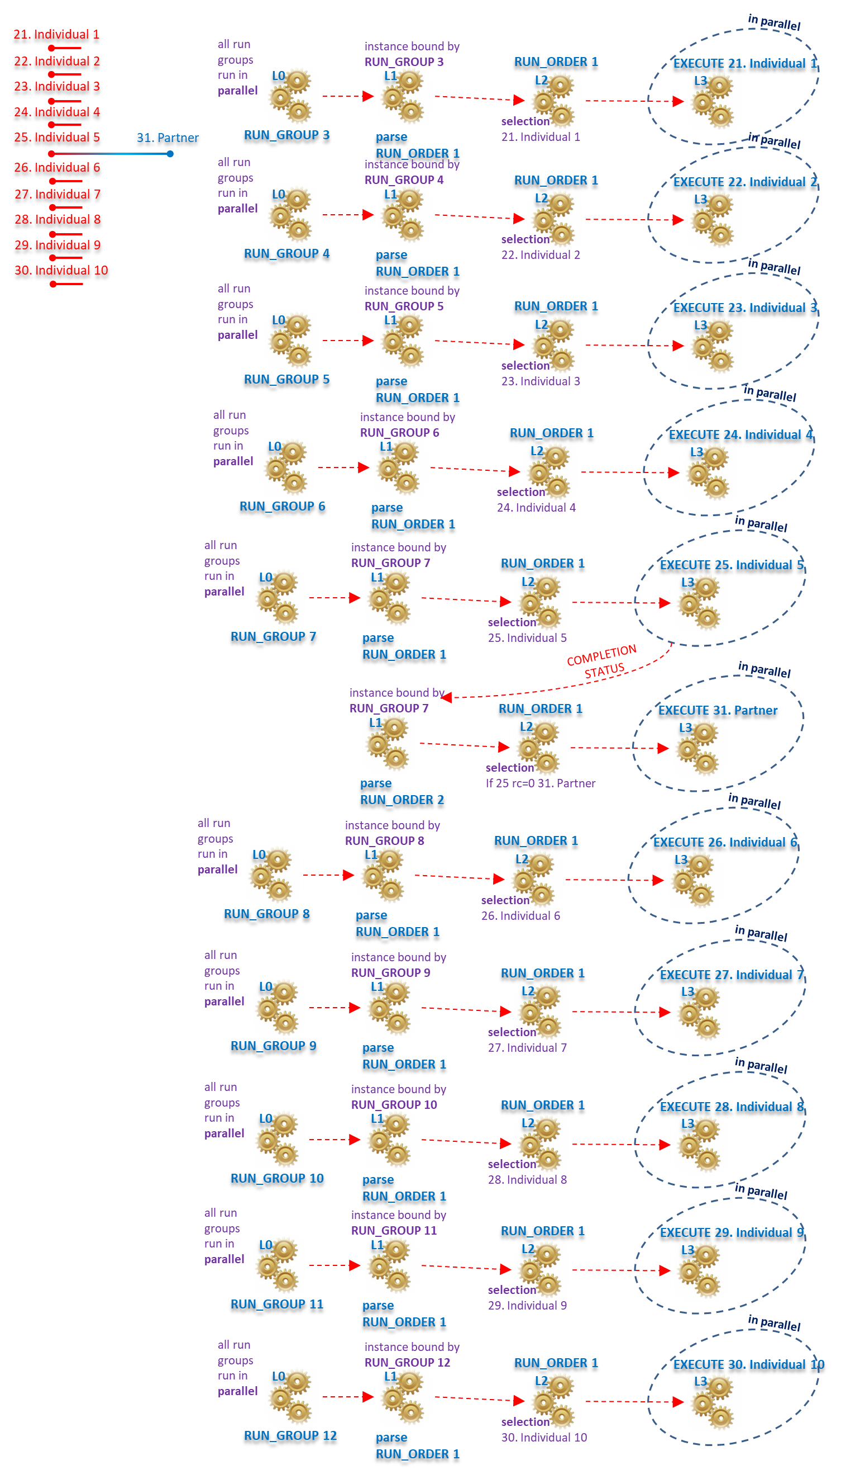

Slide 22
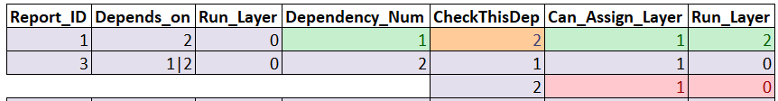
this was assigned within the same loop iteration

Slide 23
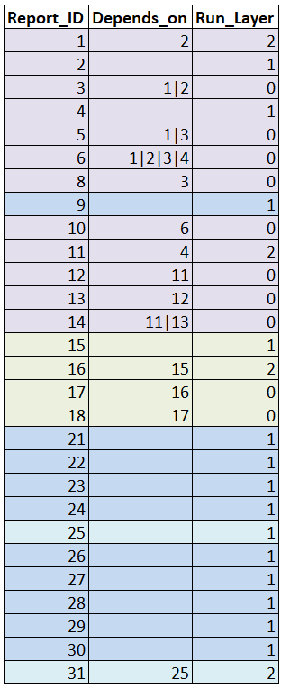
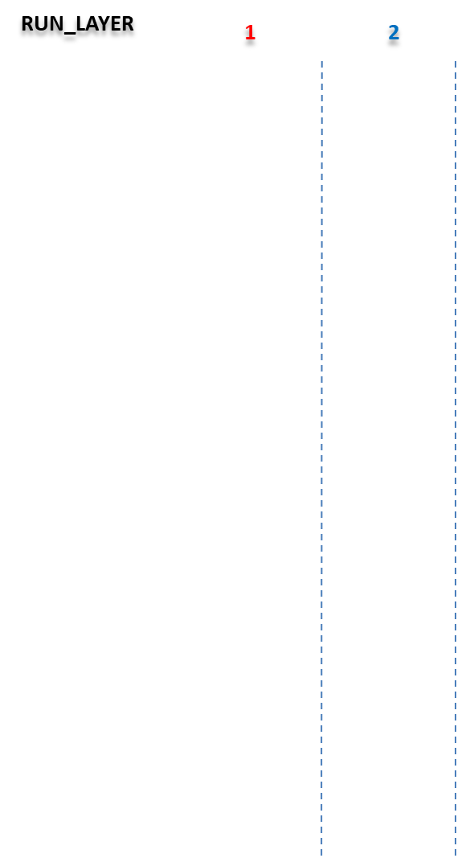
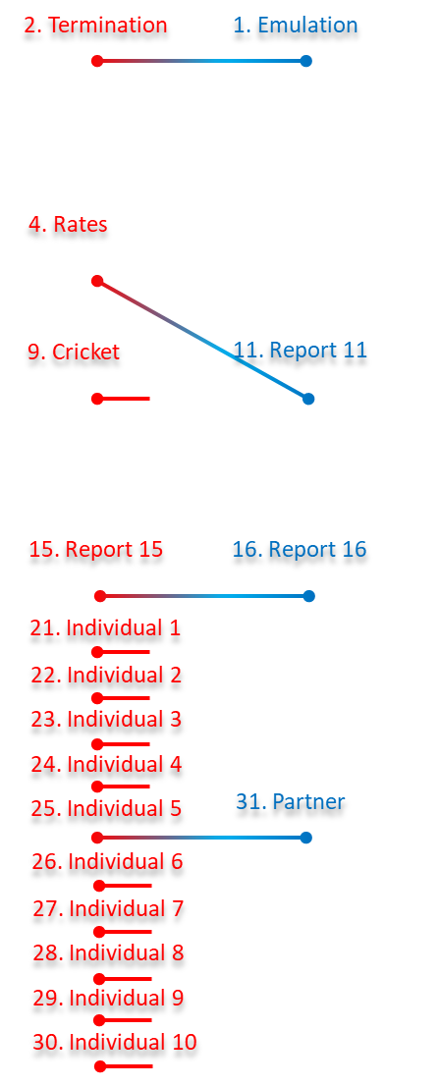

Slide 24
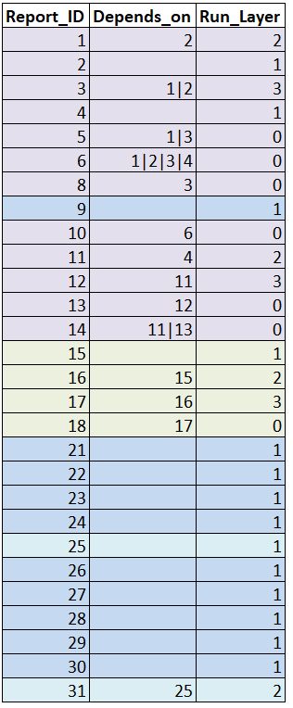
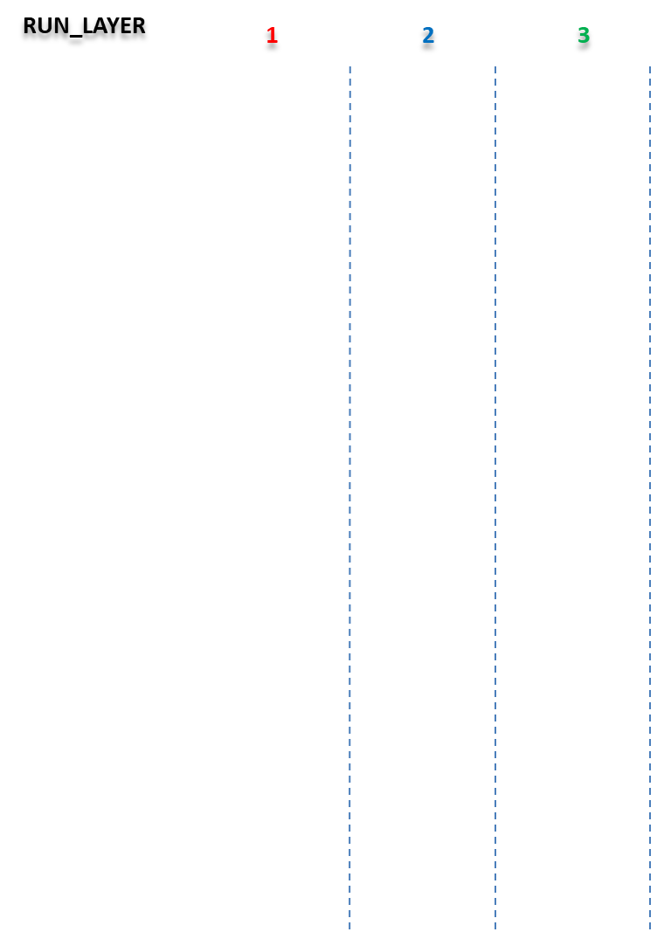
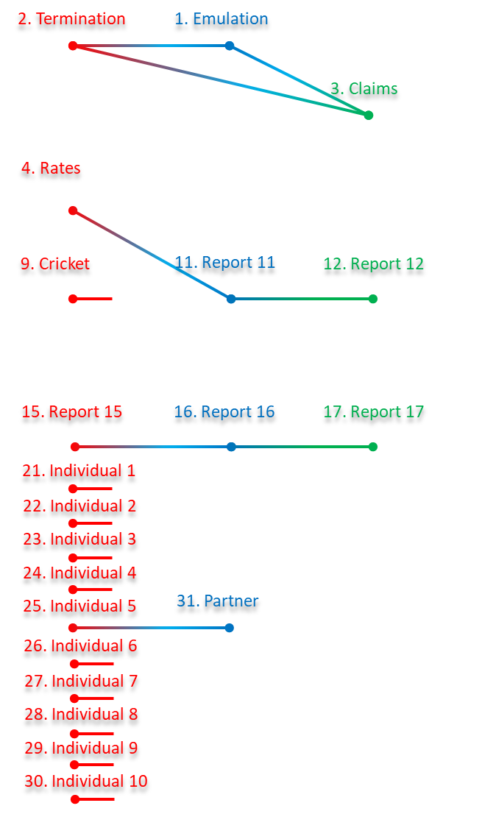

Slide 25
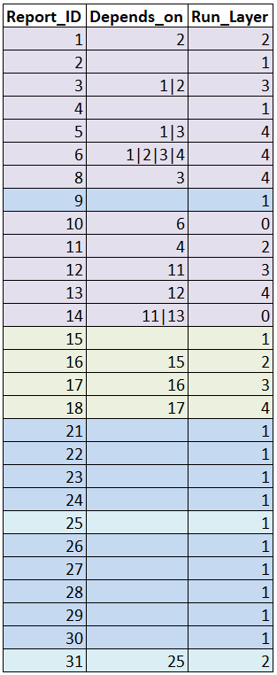

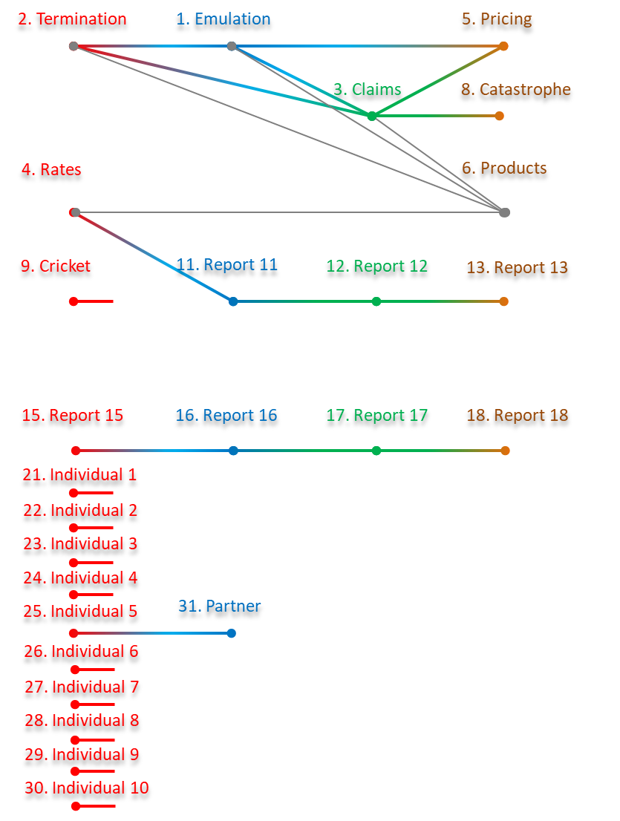

Slide 26
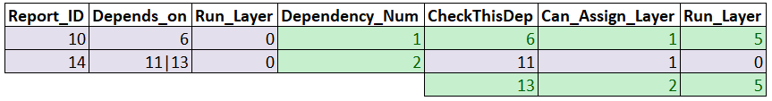

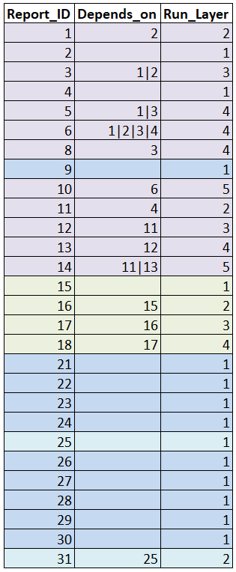
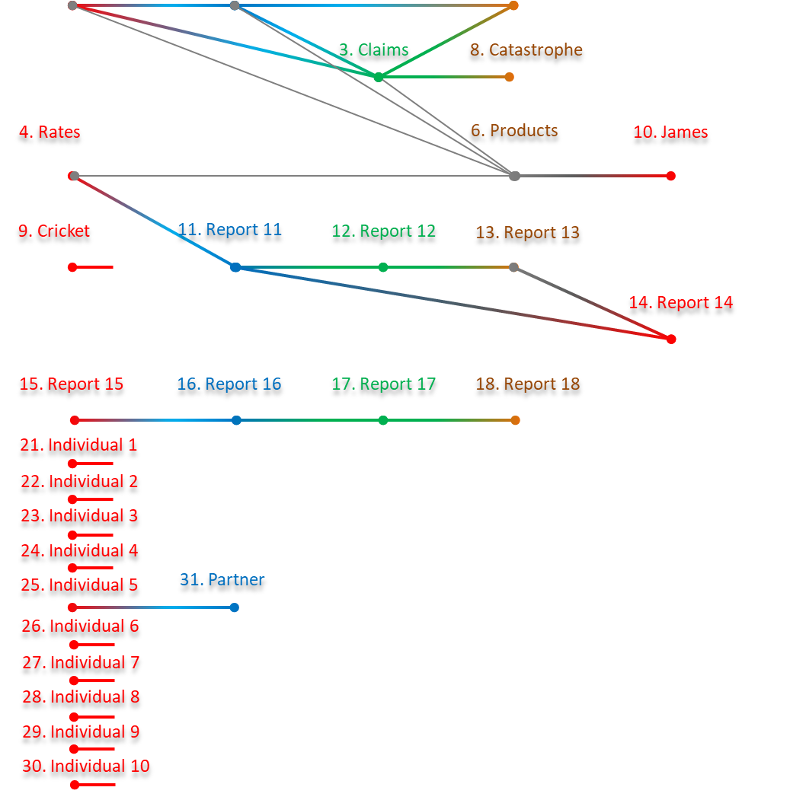

Slide 27
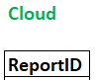
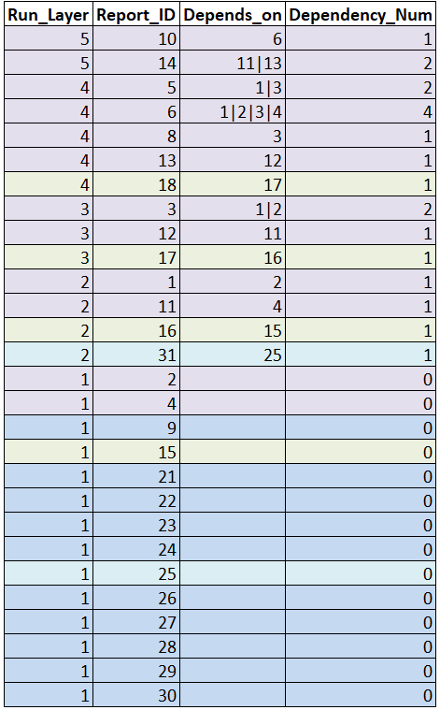

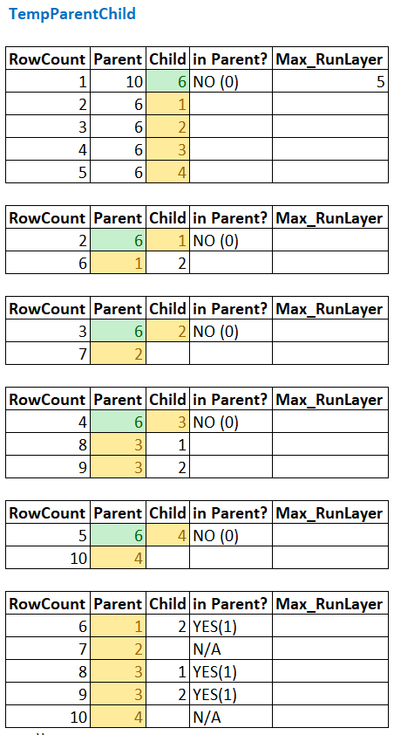
read this hash table
ID: 10 In HASH cloud?
start from the top
NO, proceed to populate TEMP Hash
Expand dependencies
follow through on dependencies
if child not in parent then expand
if child in parent then nothing to expand

Slide 28
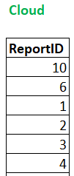
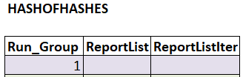
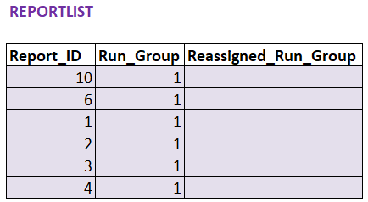
load unique report IDs to cloud
create instance
load unique report IDs to cloud

Slide 29
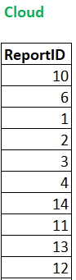
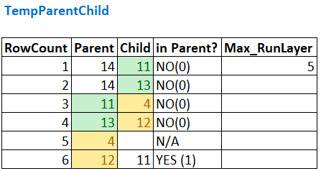
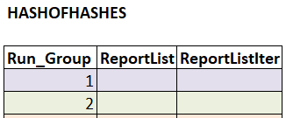
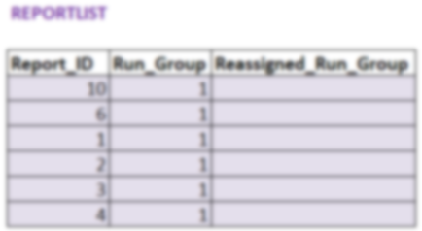
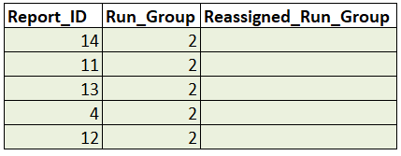
ID: 14 In HASH cloud?
NO, proceed to populate TEMP Hash
next
update cloud
new instance

Slide 31
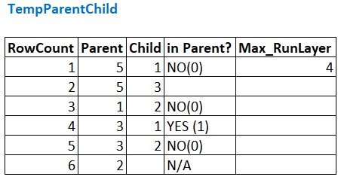
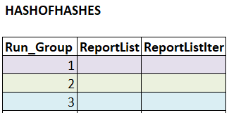
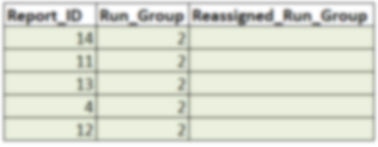
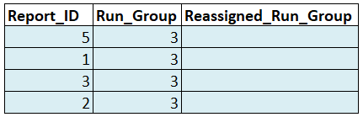
ID: 5 In HASH cloud?
NO, proceed to populate TEMP Hash
next
new instance

Slide 32
ID: 6 In HASH cloud?
YES, skip assigning this report id
next

Slide 33
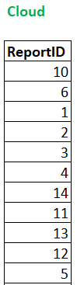




ID: 8 In HASH cloud?
NO, proceed to populate TEMP Hash
next
new instance

Slide 34



new instance

Slide 35



OVERLAP

Slide 36

SET PLACEHOLDER=1
COPY

Slide 37

PLACEHOLDER=1
Checking next instance
Are any Report IDs matching?

Slide 38

PLACEHOLDER=1
Set reassigned RUN_GROUP
Add entries because we matched REPORT ID 4

Slide 39


Slide 40

PLACEHOLDER=2

Slide 41



